Slide 1







Heading toward the GPU’s….
Peter Willendrup (pkwi@fysik.dtu.dk)

Slide 2
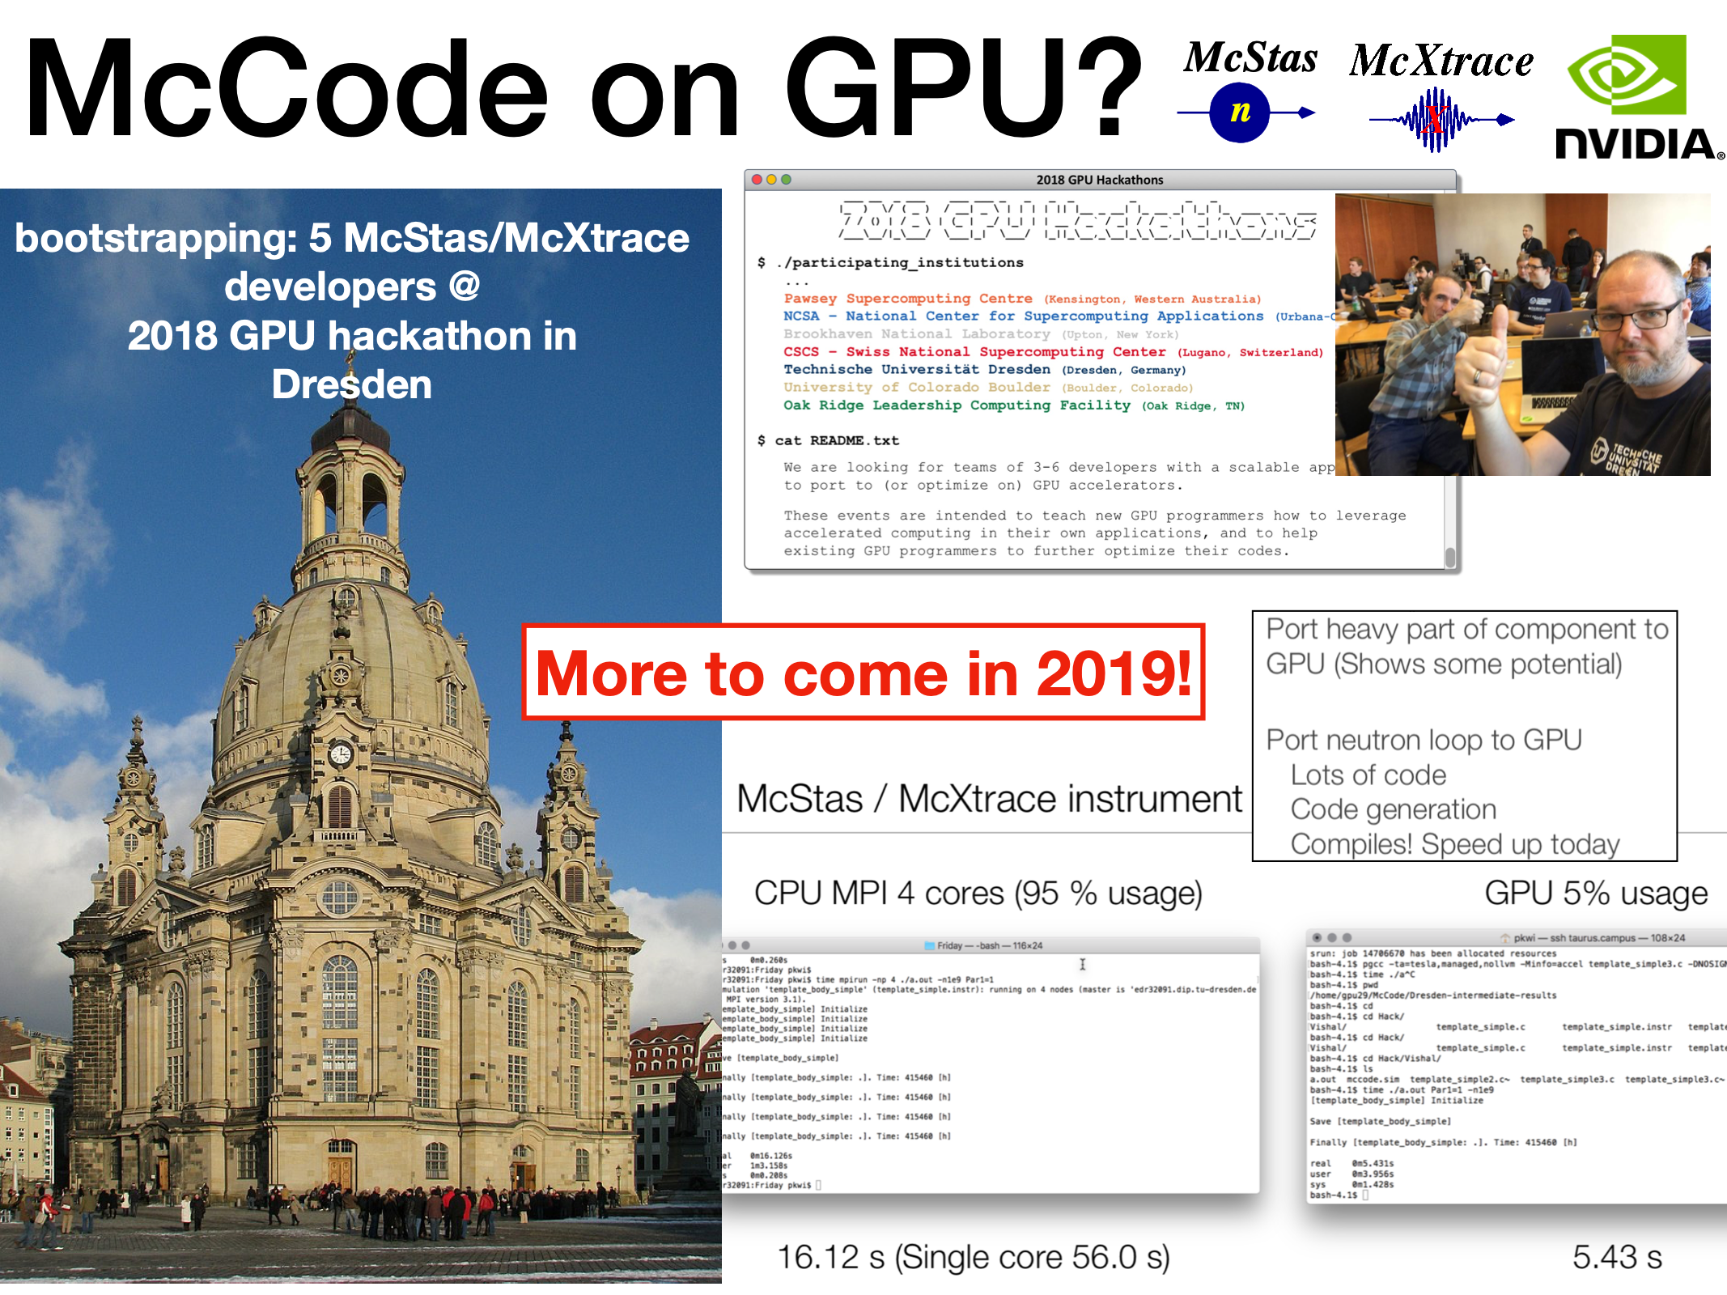
McStas + McXtrace heading for the GPU… March 2018
1st prototype, “null”-instrument with only one component. Based on NVIDIA compiler technology,
PGCC and OpenACC
pragmas

Slide 3
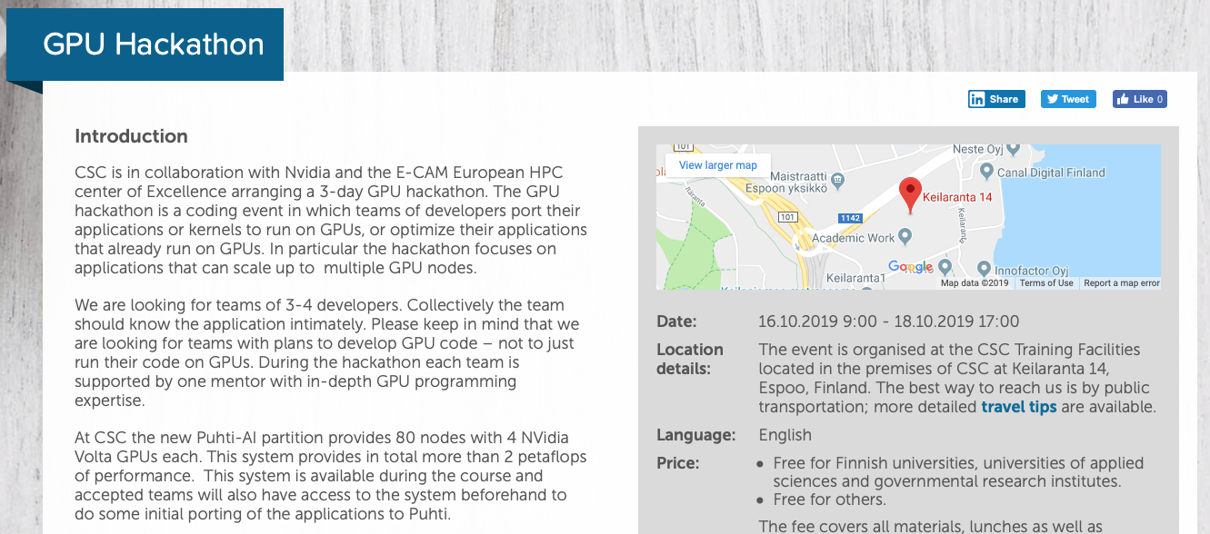
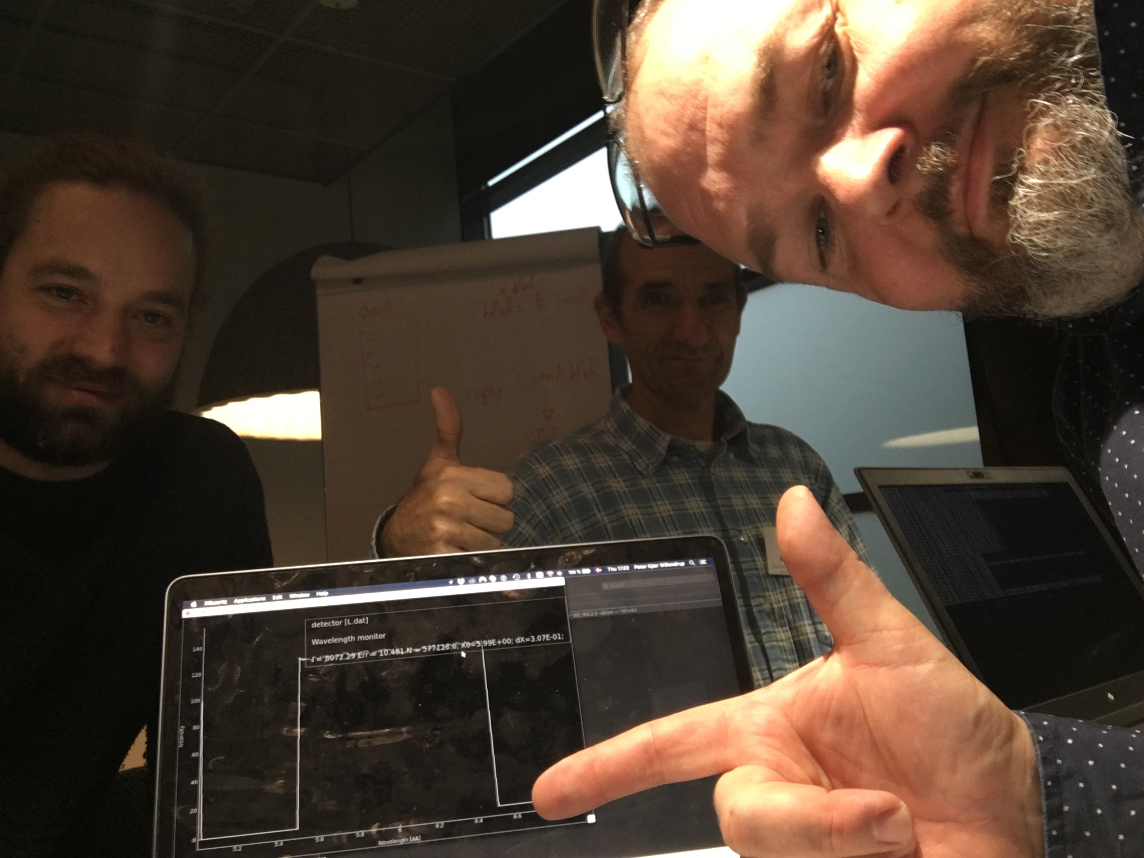
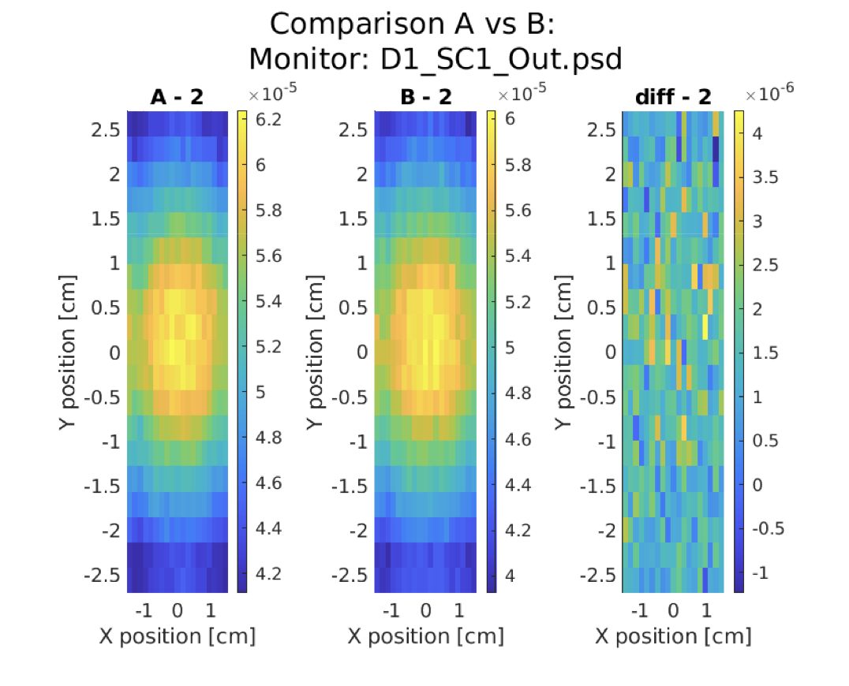
McStas + McXtrace heading for the GPU… October 2019
Rewritten code-generation with automated additions of OpenACC pragmas.
Quite transparent wrt. CPU vs. GPU First simulations with meaningful output

Slide 4
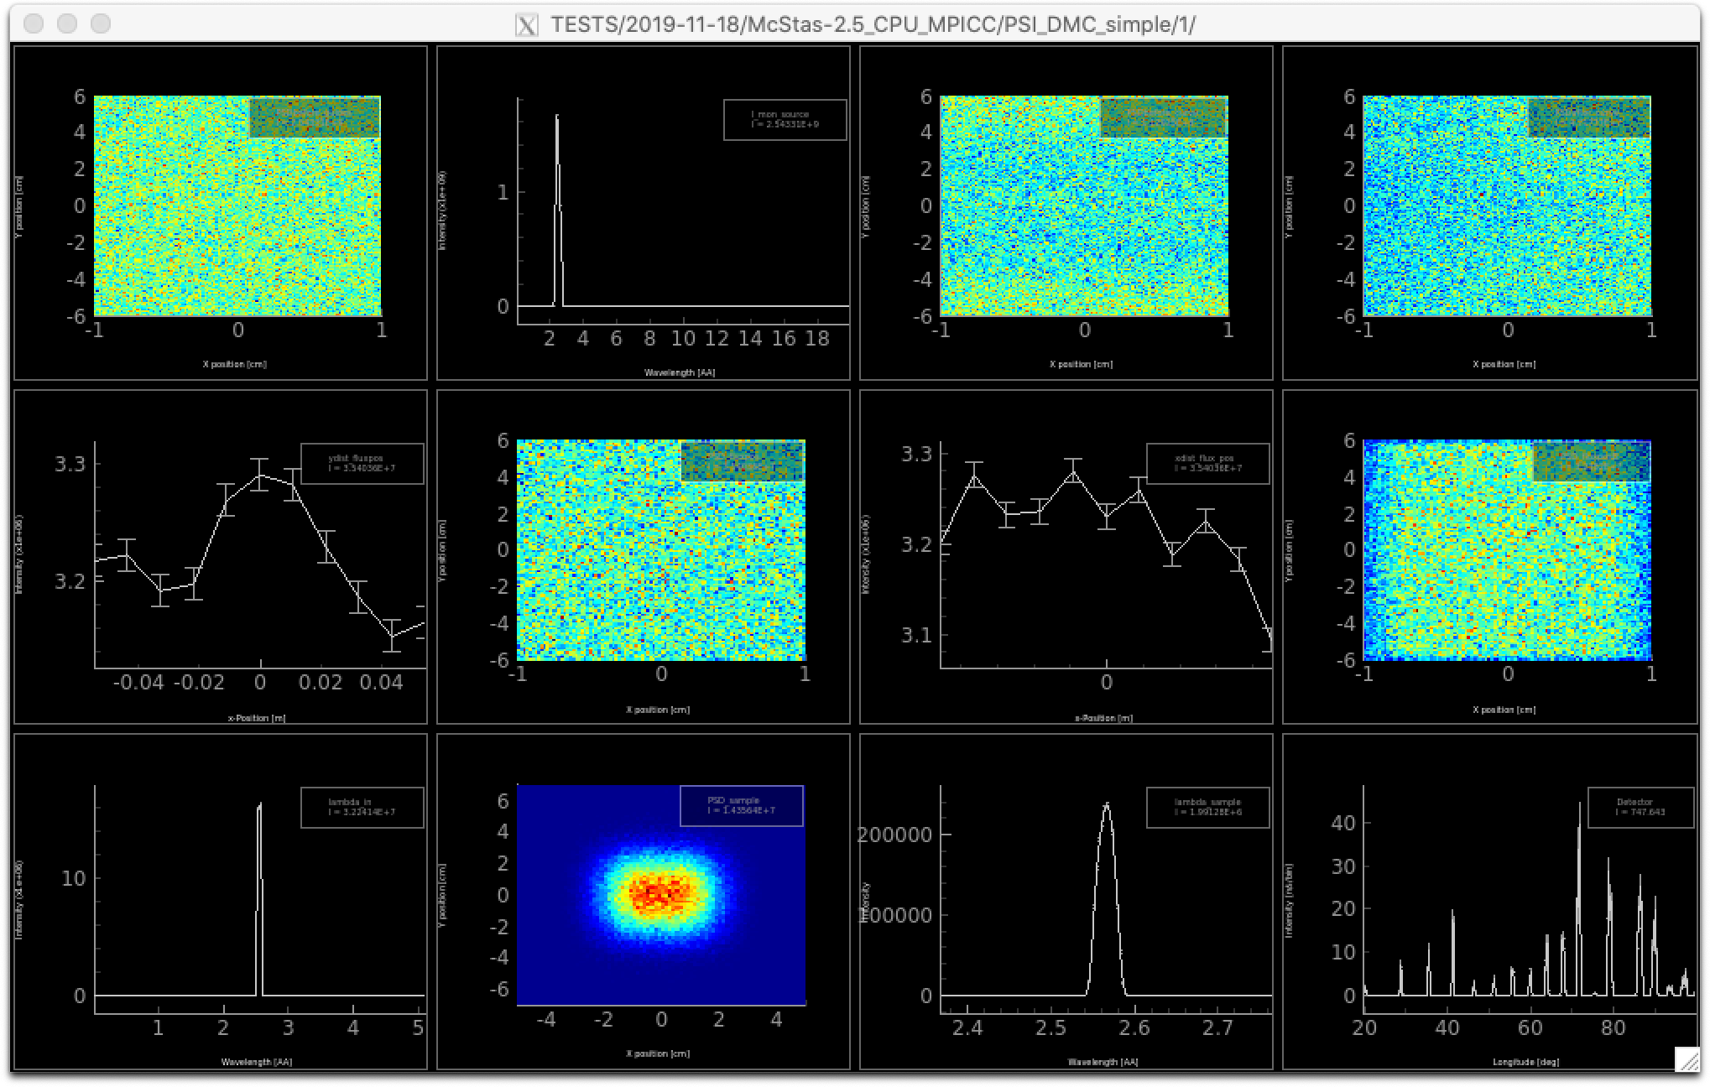
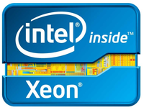
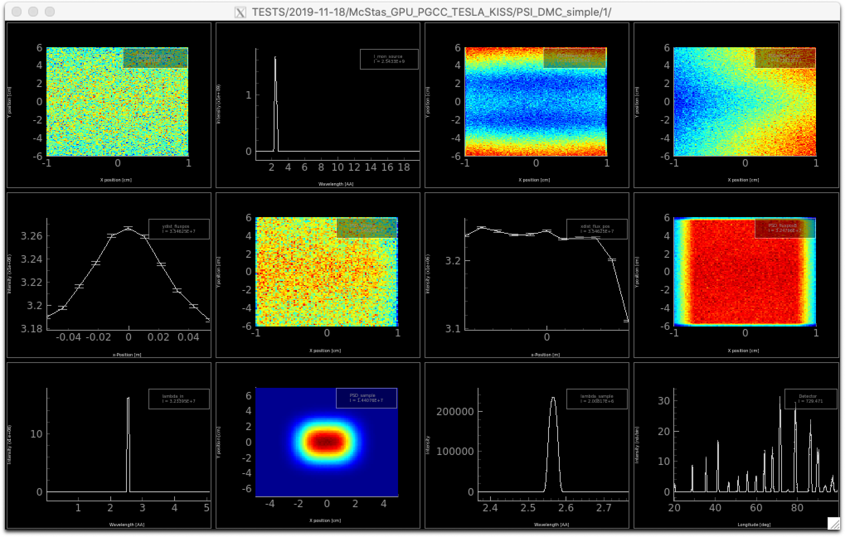
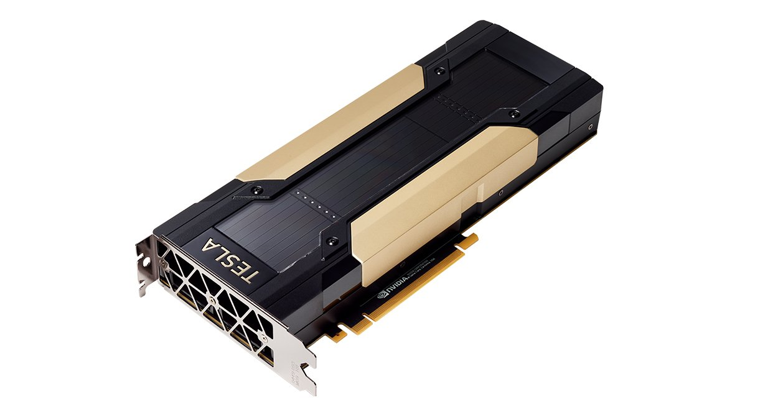
McStas + McXtrace heading for the GPU… Now
10-core MPI run, 1e7 in 2 secs
9 instruments fully
ported, also realistic
ones like PSI_DMC
Tesla V100 run, 1e9 in 22 secs
~ 2 orders of magnitude wrt. a
single, modern CPU core

Slide 5
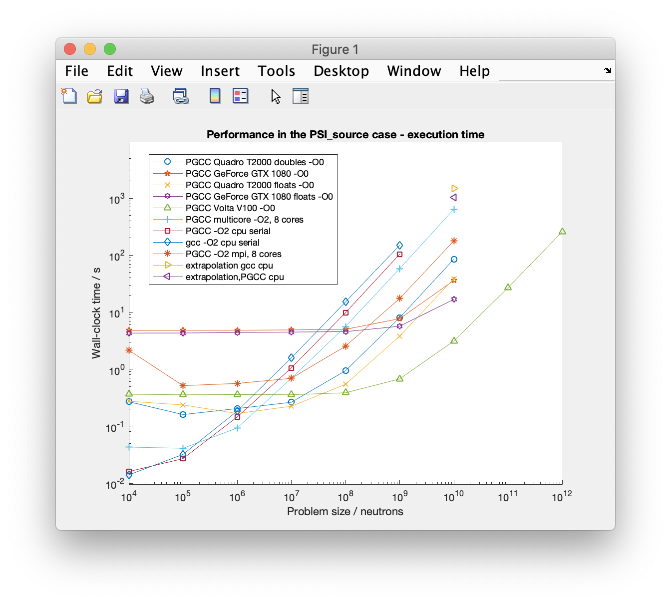
CPU
MPI
V100 (datacenter)
Quadro T2000 (laptop)
Geforce GTX 1080 (desktop)

Slide 6
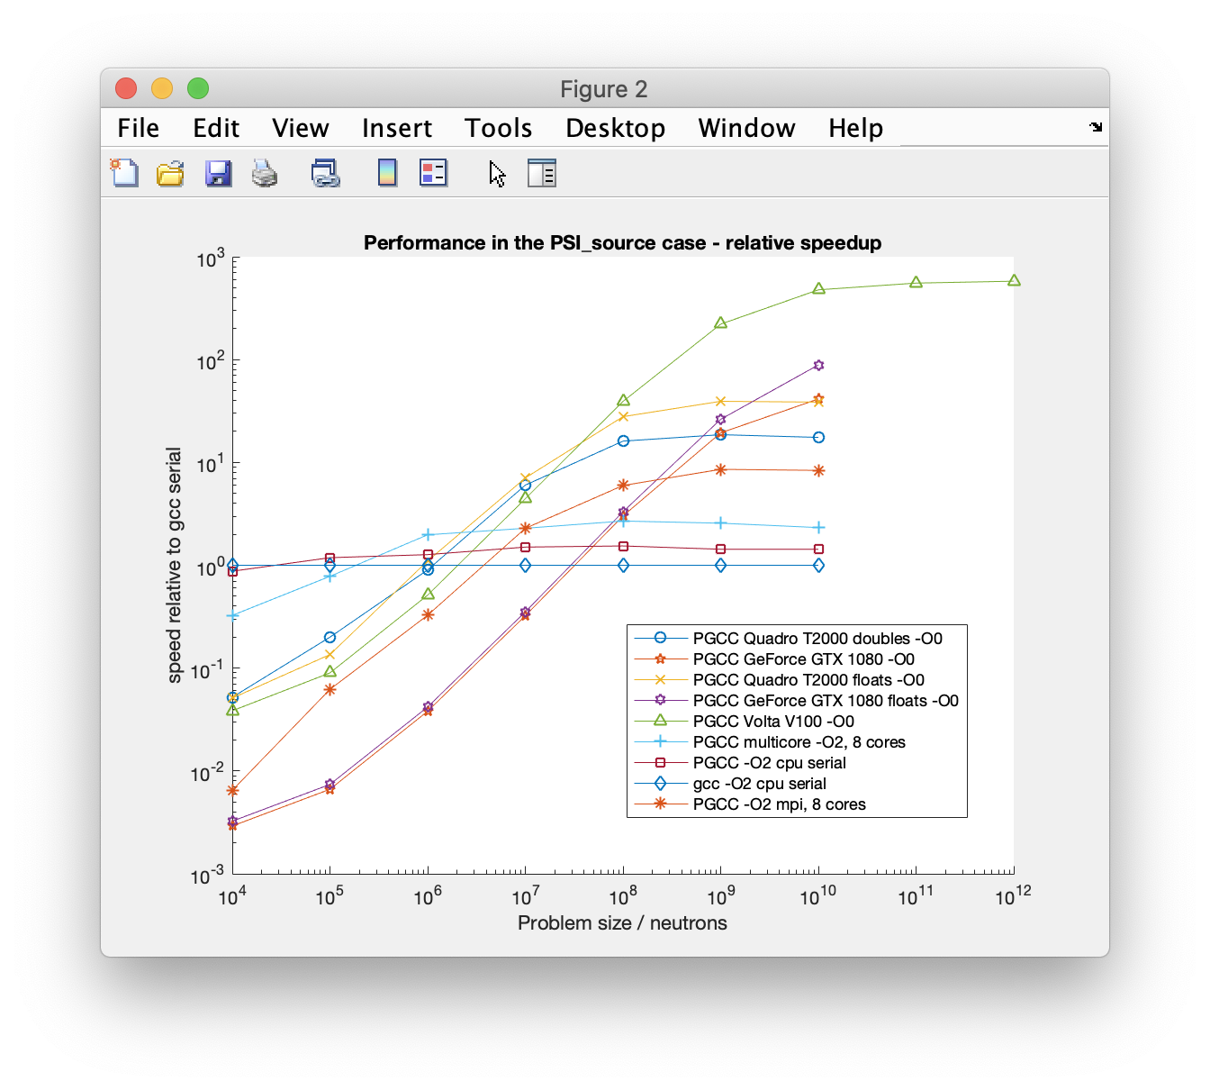

Slide 7

First step: McStas 3.0 - next generation code generator
GPU port instrument statistics:
- 21 out of 142 enabled (184 total) in mcstas-3.0 branch - these work:
PSI_DMC_simple.out
template.out
PSI_source.out
micro.out
h8_test_legacy.out
Samples_vanadium.out
Samples_Incoherent_off.out
ISIS_TS2_Brilliance.out
BNL_H8_simple.out
linup-1.out
template_simple.out
FZJ_KWS2_Lens.out
linup-3.out
Tomography.out
nano.out
Vout_test.out
templateLaue.out
ISIS_TS1_Brilliance.out
mini.out
linup-2.out
HZB_FLEX.out
GPU port component statistics:
2 Al_window
45 Arm
1 Beamstop
1 Bender
2 Brilliance_monitor
6 Collimator_linear
1 Divergence_monitor
7 E_monitor
9 Guide
1 Guide_channeled
2 Guide_curved
8 Guide_simple
1 Guide_tapering
1 Hdiv_monitor
2 ISIS_moderator
2 Incoherent
3 L_monitor
1 Lens_simple
4 Monitor
3 Monitor_nD
1 Monochromator_2foc
1 Monochromator_curved
28 Monochromator_flat
33 PSD_monitor
2 PSD_monitor_4PI
3 PSDlin_monitor
1 PowderN
12 Progress_bar
1 Selector
1 Single_crystal
46 Slit
2 Source_Maxwell_3
1 Source_div
2 Source_gen
11 Source_simple
3 V_sample
1 V_selector
- i.e. 37 out of 207 total in mcstas-3.0 branch
Limited-functionality “beta” release to be made public soon (jan-feb) after 2.6 (december)
Expect bugs!
Only a subset of components / instruments
Event interchange with 2.6 possible via MCPL
Main purpose: get this working in ‘the wild’
Your instruments will likely require (limited) rewriting
E.g. the declare section cannot include assignments
Your own components will likely require rewriting
E.g. the declare section cannot include assignments
Arrays must be declared/initialized using a new set of functions (i.e. not double PSD_I[nx][ny] with definition parms)
Hence some backward compatibility is lost and we need to increment major release #

